Slide 1

Digital locksmith

Slide 2
CONTENTS
Introduction
Primary Features
Technologies Used
Implementation
security
Conclusion

Slide 3

IN TODAY’S WORLD WHAT IS THE KEY ASPECT THAT SAFEGAURDS OUR DIGITAL LIFE?
“PASSWORD”

Slide 4

DIGITAL
LOCKSMITH
A system designed to manage and secure online passwords

Slide 5

Why digital locksmith
Security
Increasing number of Accounts
Prevention of Identity theft
Convenience
Compliance

Slide 6

Primary features
User Authentication
Password
Encryption
Intuitive
Interface
Data Integrity
& Security
Search &
Organization
Secure login system for users to access their password vault
Robust Encryption methods to protect stored passwords
User-friendly interface with easy addition, retrieval and management of passwords
Protected unauthorized access or data breaches
Functionalities to search specific entries and organize passwords
efficiently

Slide 7

Target Audience
General Internet Users
Security-Conscious Individuals
Small Businesses
Individuals who manage multiple online accounts and need a convenient way to securely store and manage their passwords.
Users who are aware of digital security risks and prefer a secure method for handling their passwords.
May benefit from this tool to manage shared passwords for various online services and platforms.

Slide 8





Technologies/languages used
Python
HTML
CSS
Java Script
PostgreSQL
Used Django python
Frame-work
Front End pages development
For Styling
For Client-Side interactivity
Database

Slide 9
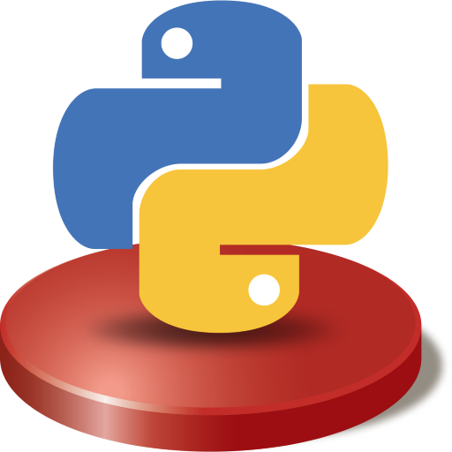
WHY DJANGO?
Protection Against Common Attacks
Secure Password Management
Offers additional security controls and policies.
Regular Updates
Https Support
Efficient Database Handling

Slide 10
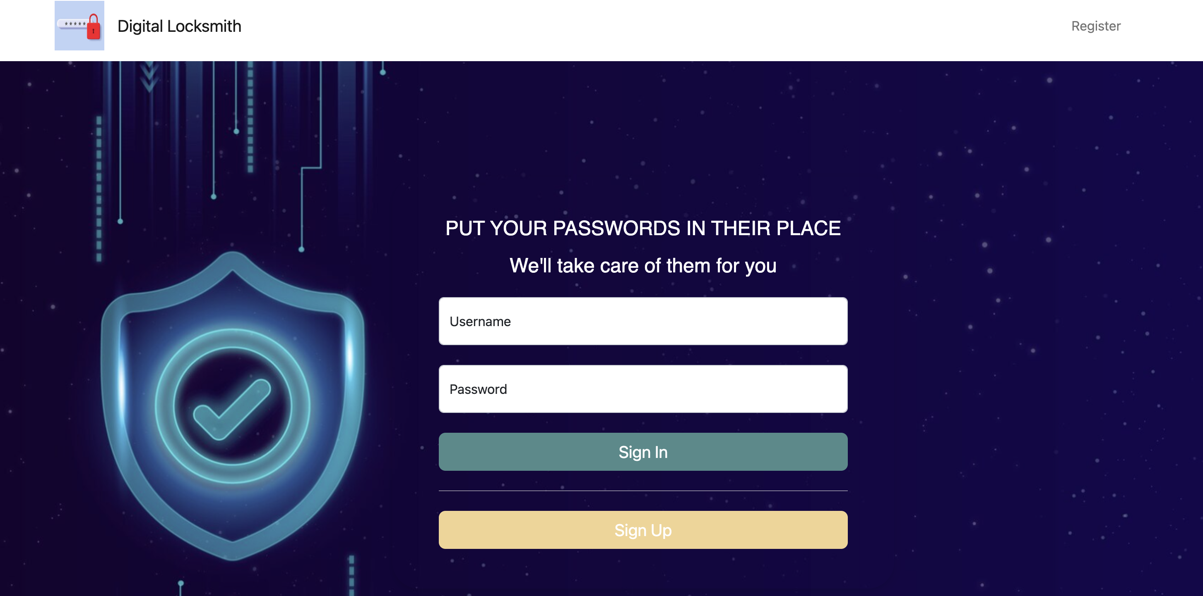
Login page

Slide 11
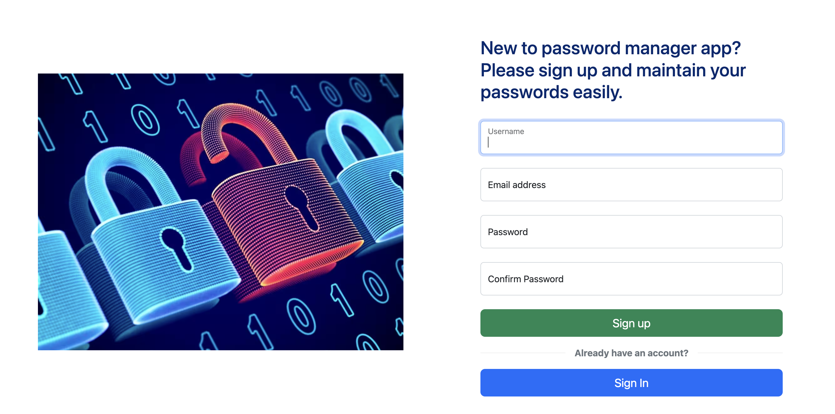
SiGN up page

Slide 12
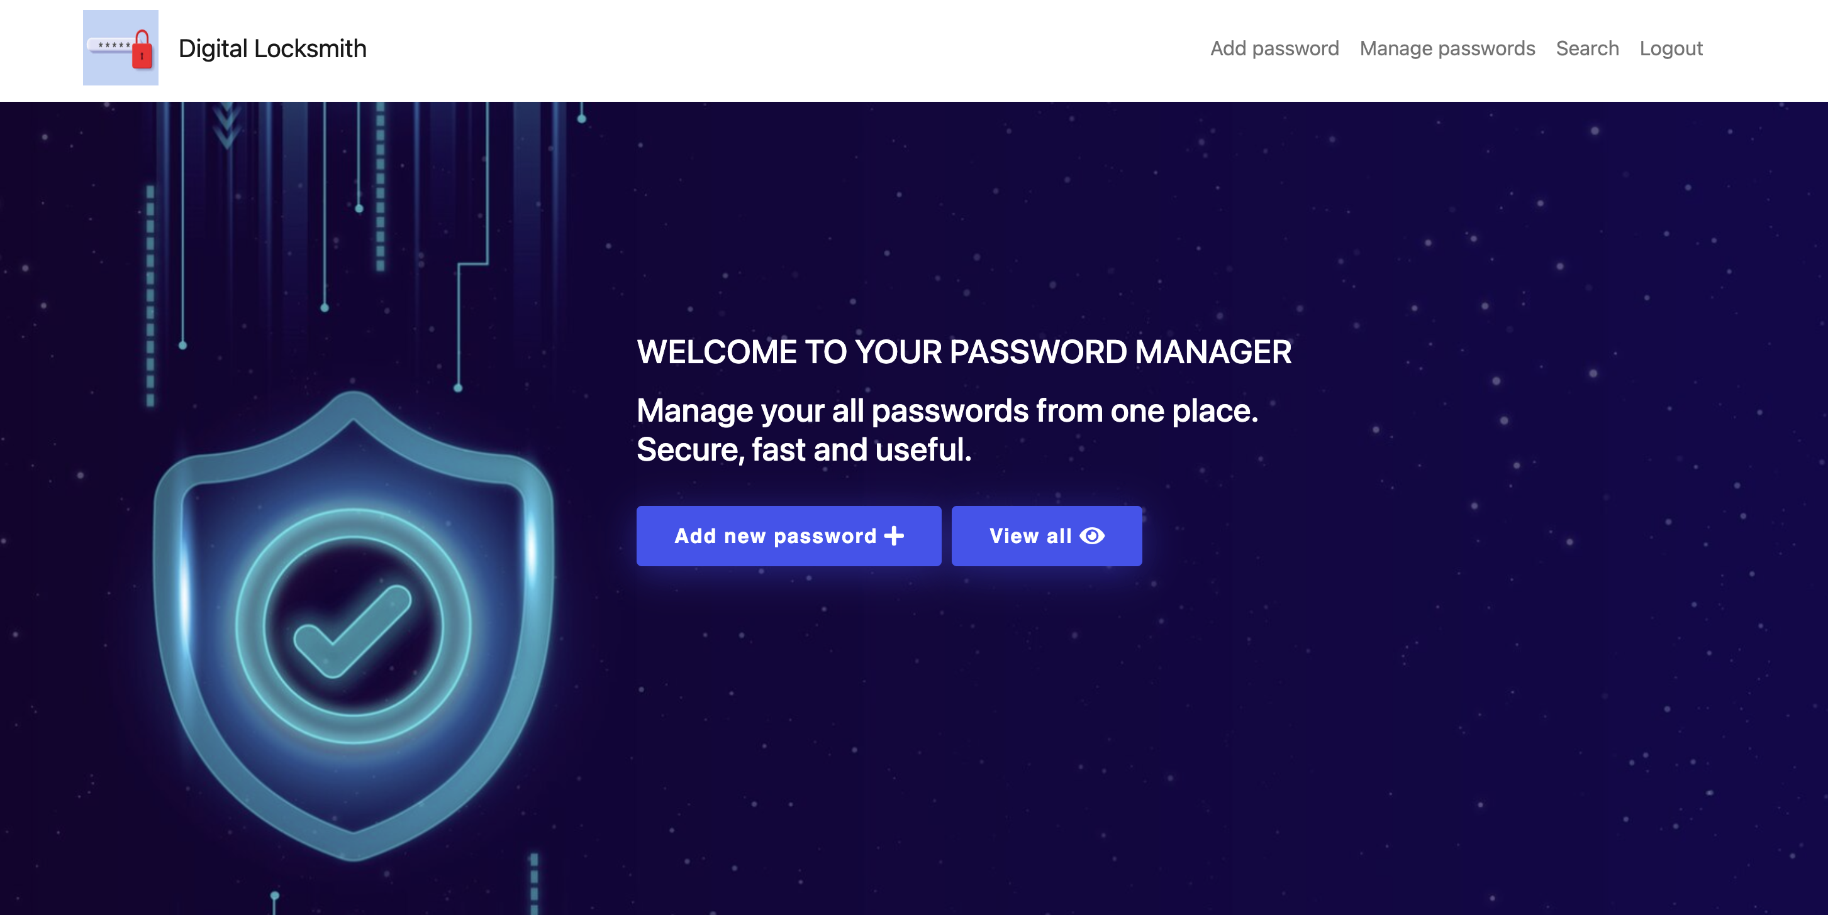
Home page

Slide 13
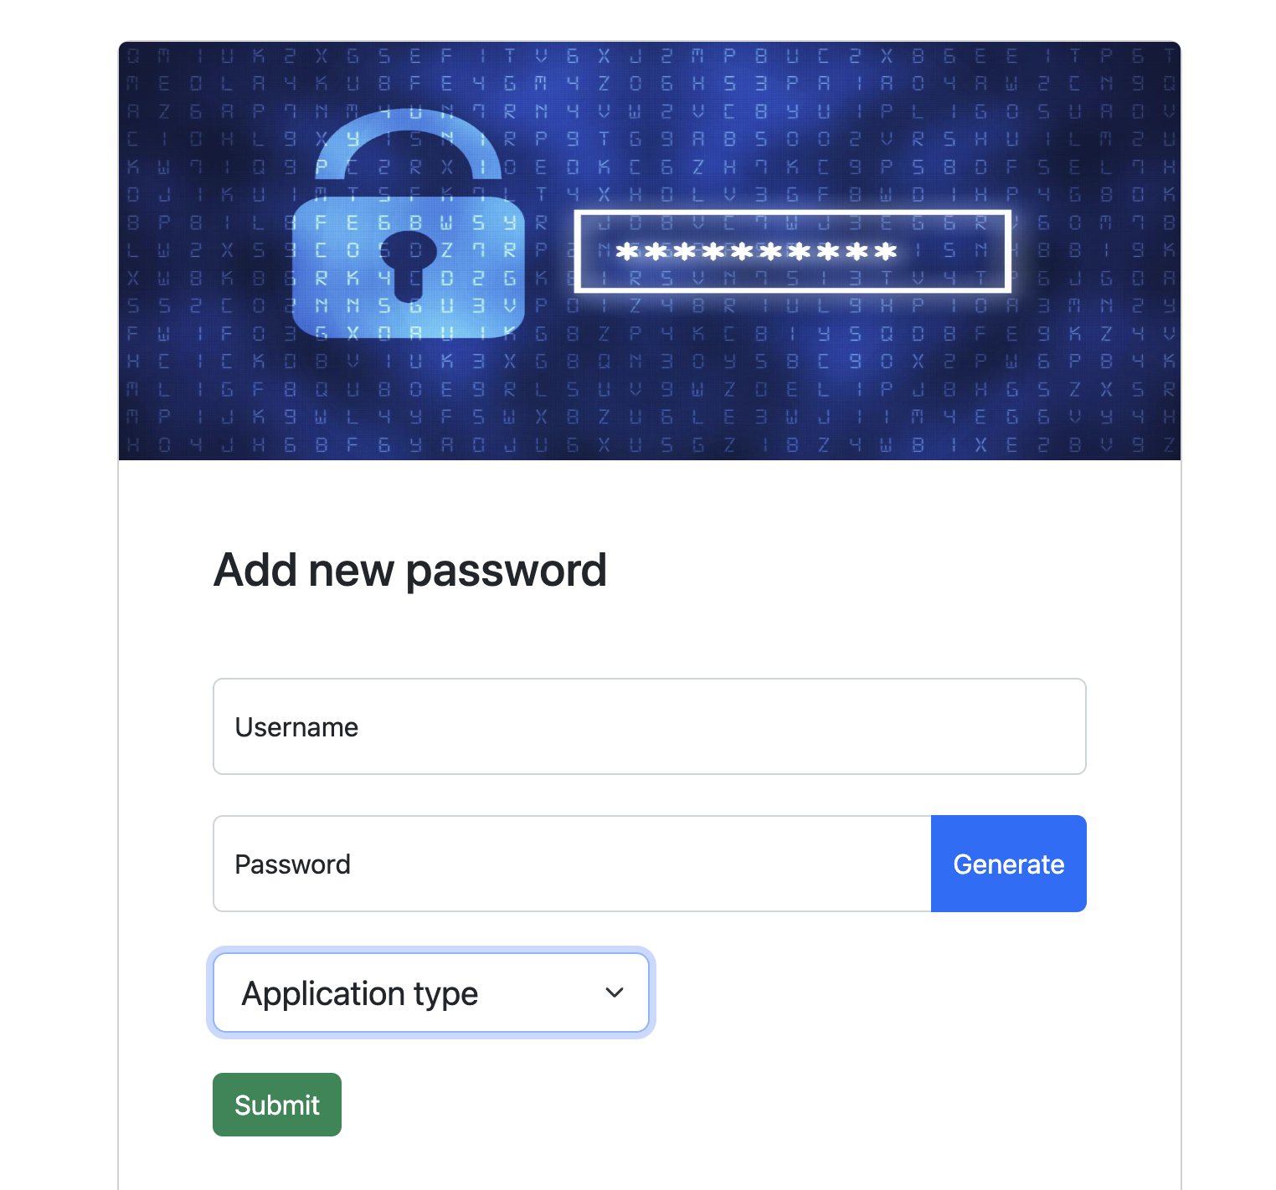
Add password page

Slide 14
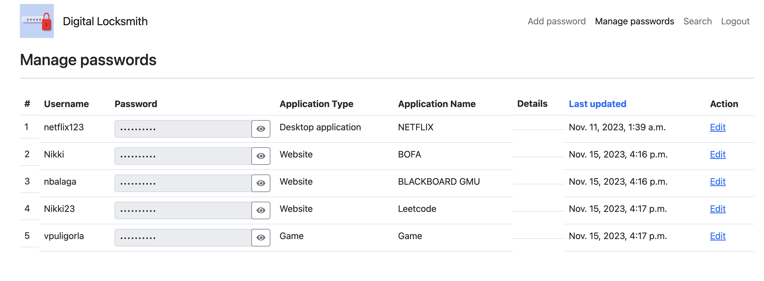
MANAGE PASSWORD PAGE

Slide 15
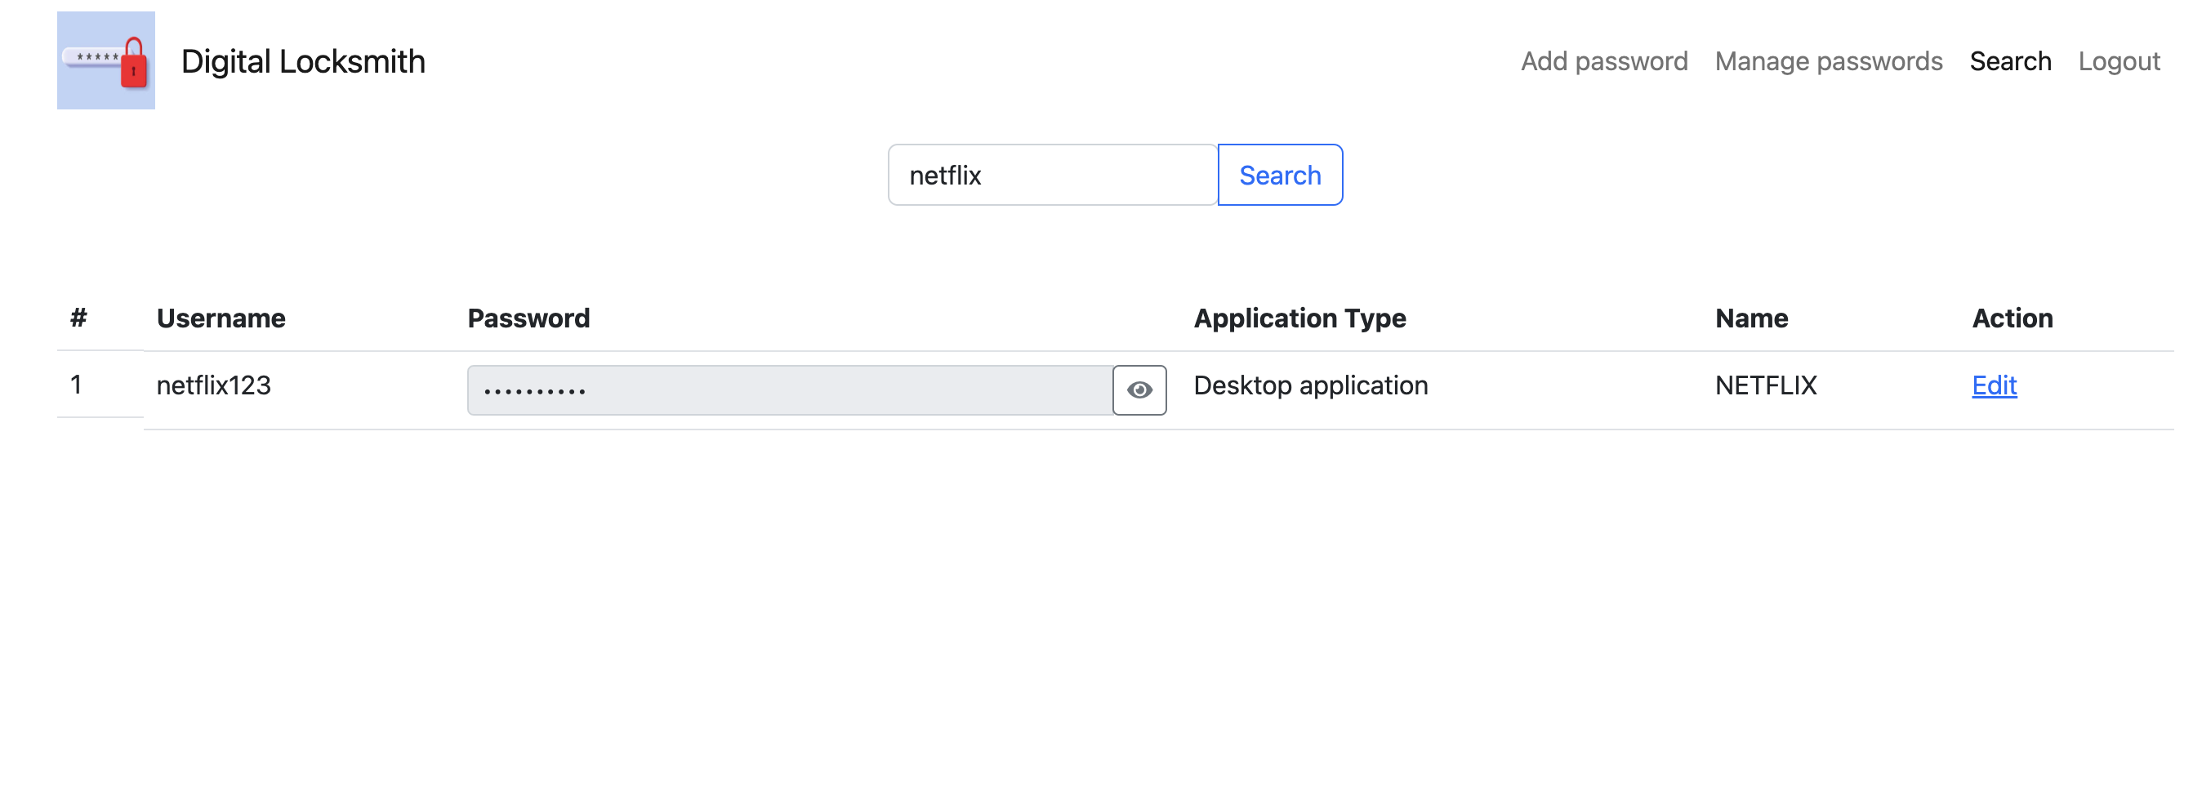
SEARCH PASSWORD PAGE

Slide 16
features emphasised
1. Authenticity: Verifying the identity of a user or the genuineness of data. 2. Data Integrity: Ensuring data remains accurate and unaltered throughout its lifecycle.
3. Confidentiality: Protecting information from unauthorized access and disclosure.

Slide 17
Authentication
Users create accounts by providing credentials (like username and email) and setting up passwords.
During login, the system verifies these credentials against stored data to authenticate users.

Slide 18
Authentication
Session Management : Once authenticated, users are granted a session. Django tracks user sessions to maintain their authenticated state as they interact with the application.
Security Measures for Authentication : Implementations like CSRF tokens in forms, which Django handles automatically, to prevent unauthorized form submissions.

Slide 19
Confidentiality
Password Protection : Passwords stored in the database are not kept in plain text. Instead, they are encrypted using strong hashing algorithms (like PBKDF2, bcrypt, or Argon2), which are standard in Django. This means even if the database is compromised, the actual passwords remain protected.
HTTPS/SSL Implementation: The project is likely configured to use HTTPS, ensuring that data transmitted between the user's browser and the server is encrypted. This secure data transmission prevents eavesdropping and man-in-the-middle attacks.

Slide 20
Confidentiality
User-Specific Data Access: The application ensures that users can only access their own password data. Proper session management and authentication checks prevent one user from accessing another user's data.
Secure File Handling and Storage: If the application handles files or other sensitive data, these would also be securely stored and managed. Measures would be taken to ensure that files are not accessible to unauthorized users.
Environment Variable for Sensitive Data: Critical information, like database credentials and secret keys, are stored in environment variables, not in the codebase, to

Slide 21
Data Integrity
Django’s ORM (Object-Relational Mapping): Django’s ORM acts as a layer between the application and the database, ensuring that data is correctly stored and retrieved. It prevents SQL injection attacks, which can compromise data integrity, by using parameterized queries.
Form Validation: Django forms come with built-in validation that checks for erroneous or malicious data before it’s saved to the database. This includes type checking, length validation, and custom validation rules as needed.
Model Constraints: Django models can be configured with various constraints (such as unique, max, length, etc.) to ensure data consistency and adherence to business rules.

Slide 22
Data Integrity
Transactions: Django supports database transactions, ensuring that a series of database operations either complete entirely or not at all. This is crucial for maintaining data consistency, especially in the context of operations that involve multiple steps or updates.
Data Backup and Recovery Strategies: While not always part of the Django framework itself, a robust data backup and recovery plan is essential for maintaining data integrity. Regular backups and a clear recovery plan ensure that data can be restored to a consistent state in the event of corruption or loss.
Input Sanitization: Ensuring that all user input is sanitized before being processed or stored helps prevent issues like script injections, which can corrupt or alter data.

Slide 23
SUMMARY
The project effectively utilizes Django's powerful features, including its ORM, security mechanisms, and user-friendly templating system, to create a reliable password management tool. It also has room for further development, such as implementing two-factor authentication, cloud synchronization, and cross-platform support, which would greatly enhance its functionality.

Slide 24
THANK YOU
Vinitha Puligorla
Nikhitha Balagani

Slide 25


ANY QUESTIONS?

